Slide 2
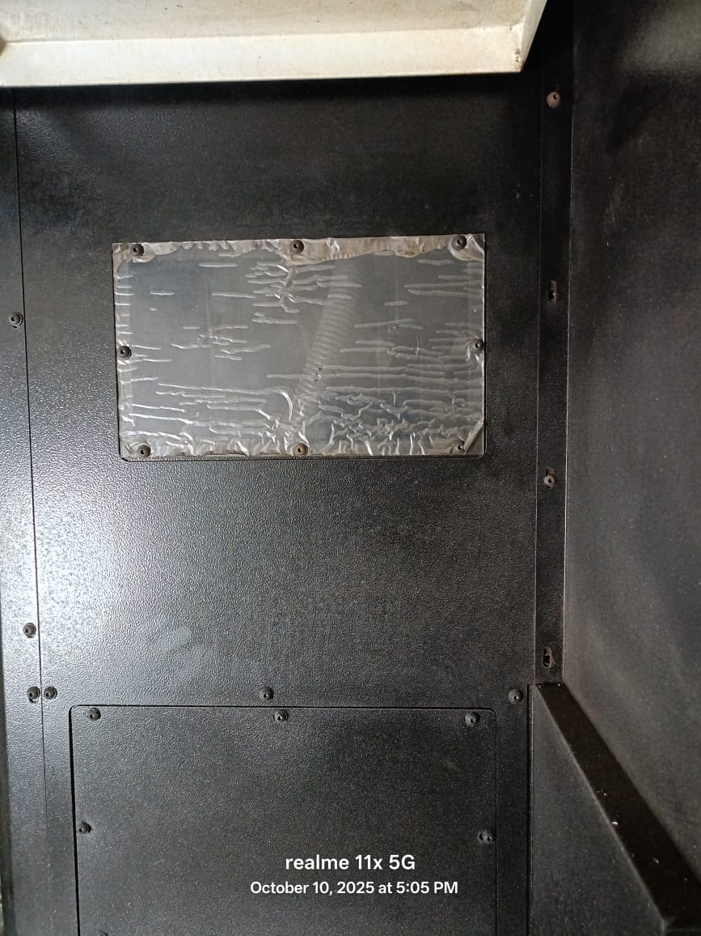
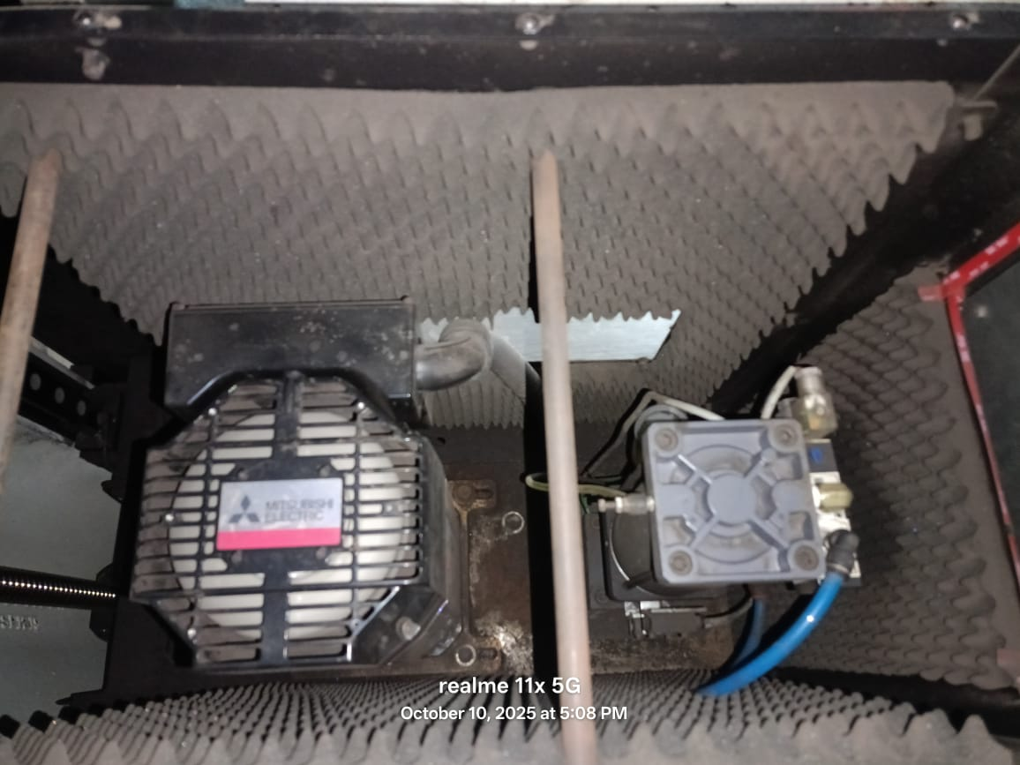
Major Service Issue
PROBLEM : Cvm 1370 y axis lm guide replacement take more time and difficulty due to its taper. So how to lift saddle without crane
SUGGESTION : Need to install bracket on y axis saddle temporarily with the help of bolting
PROBLEM : For Spindle Fan removal, first, we need to open the left-side cover.
SUGGESTION : increase the size of the acrylic window of the spindle cover; otherwise, make the cover in two vertical parts.

Slide 3
PROBLEM : FRC Cable Issue
SUGGESTION : Both side connector quality issue
PROBLEM : Axis Bearring Failure Issue
SUGGESTION : We have done a lot of efforts to stop bearing failure and almost succeed. I want to suggest that when a machine is loaded from our factory, at that time, x and y axis are separately locked by fixture plate because the motor is in the servo lock and the axis is free at the time of transportation and any movement at that time directly affects the mechanical portion of the machine. Due to this, the bearing may be damaged

Slide 4
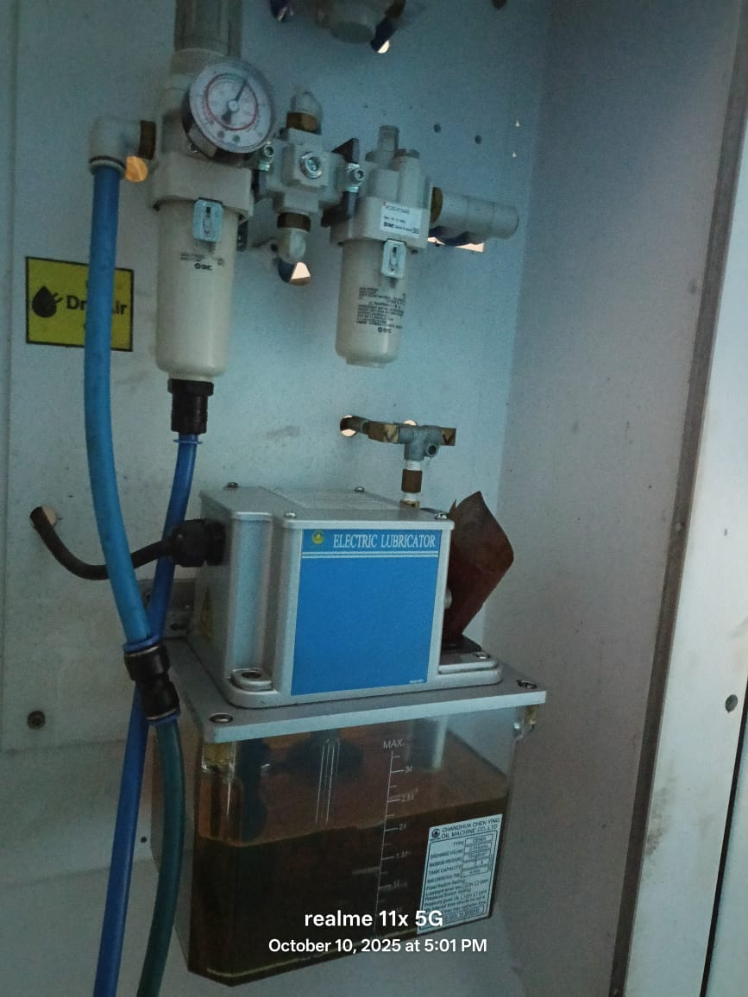
PROBLEM : Lubrication Unit mounting problem
Due to the taper present in the guarding below the lubrication unit, we are facing problem in taking out the tank. Also, the lesser space between lubrication unit and FRL unit creates prolem in opening the screws
SUGGESTION : Increase the distance between the lubrication unit and the FRL unit and also make the guarding below the lubrication unit flat.s

Slide 5
PROBLEM : Spindle Heating problem
In the models above CVM 1050, roughing program takes too much time because of the large dyes running on them. Due to this continuous operation on the spindle, it gets heated.
SUGGESTION : Spindle oil cooler should be made compulsory for big machines
PROBLEM : Spindle Noise problem
When operating at high rpm, the spindle makes noise during start and stop.
PROBLEM : Coolant entering in X axis motor
In the model CVM 1680, motor coupling chamber do not have drain hole due to which the coolant is collected and moves into the motor through the motor shaft
SUGGESTION : Need to check the drain hole and increase the size of drain hole

Slide 6
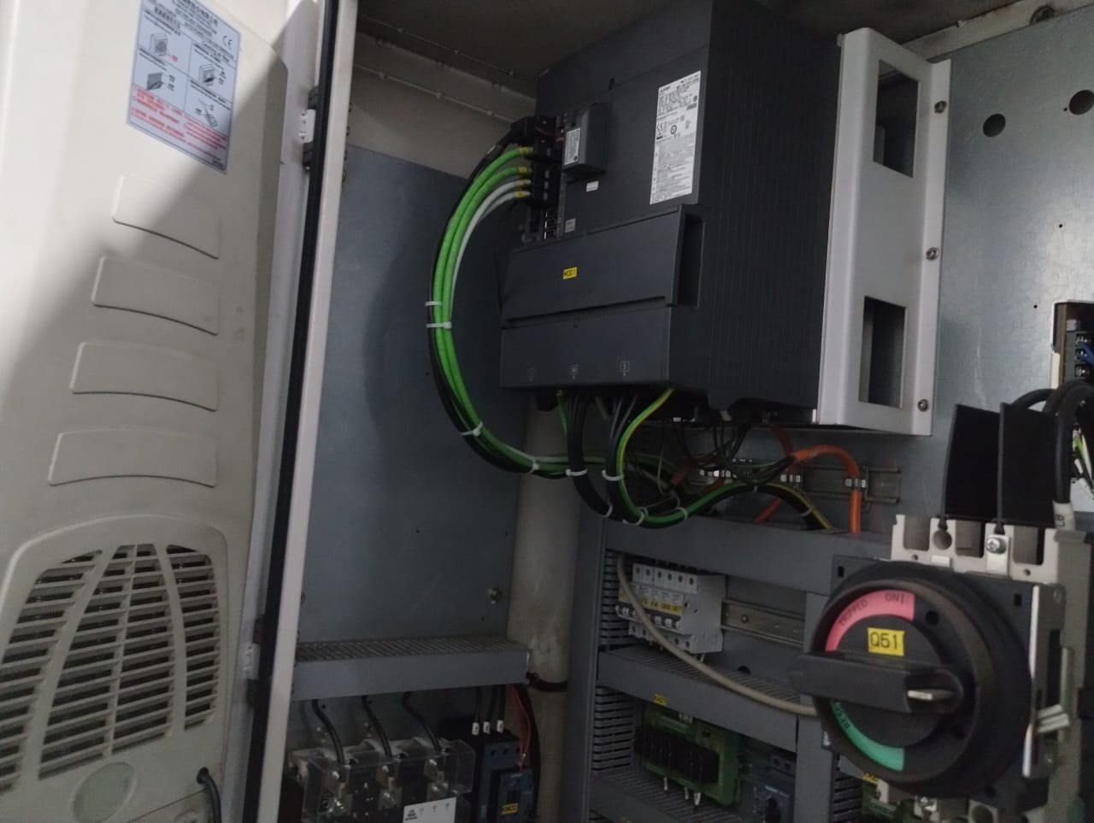
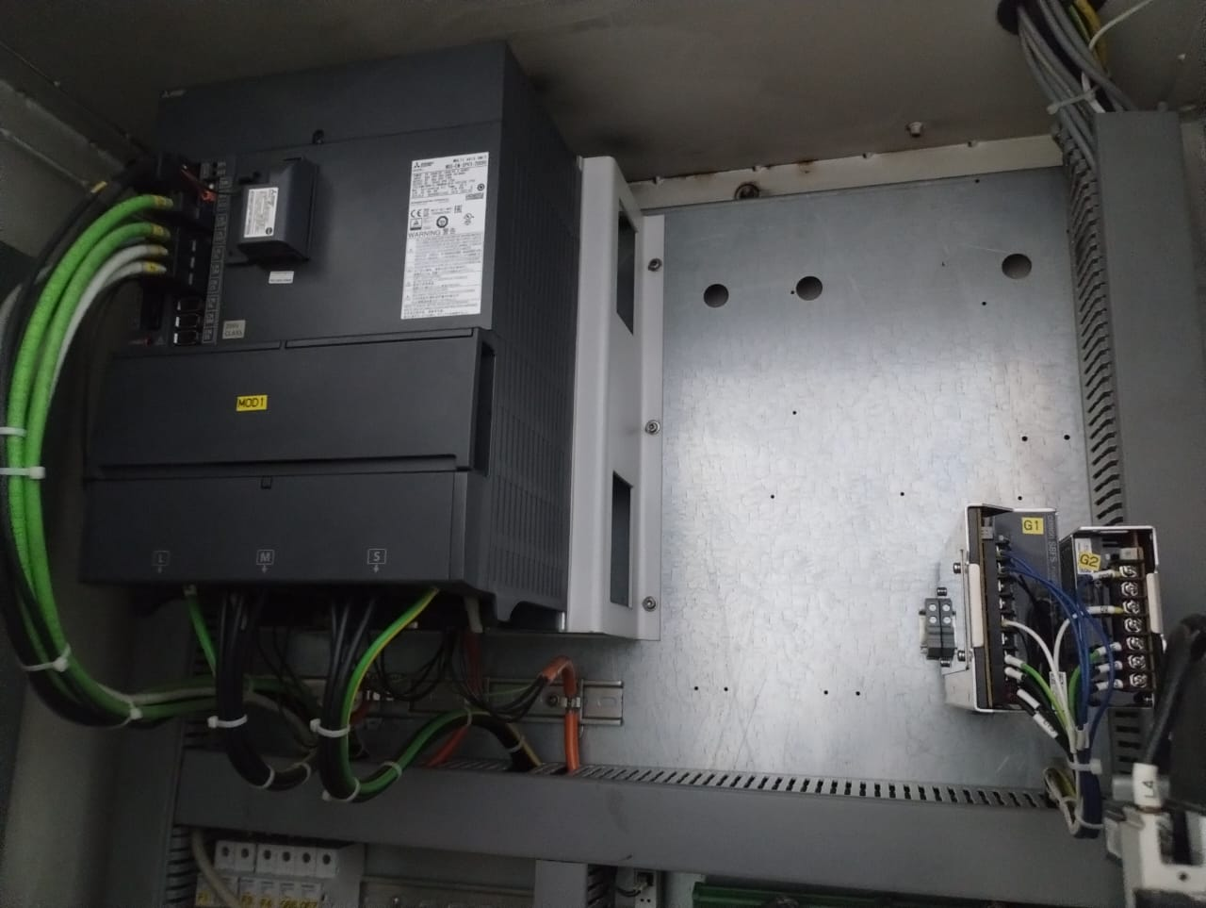
PROBLEM : Issue in changing NC unit cables and drive
Drive is installed in the left corner of electrical panel and the gate of electrical panel opens right to left. Most of the customers do not have space on the back side of machine. So it is hard to open the mounting screw of drive and pass the cables of NC unit through the hole
SUGGESTION : Install the drive in the right corner of electrical panel for all models of CVM

Slide 7
PROBLEM : Door movement tight issue
Due to the use of plastic roller, it wears out and get damaged due to which its movement becomes hard
SUGGESTION : Use metal roller instead of plastic roller
PROBLEM : Loose nuts of Cosmos display on spindle head
The nuts of the cosmos display present on spindle head opens due to vibration
SUGGESTION : Use fixit on nuts
PROBLEM : Part marking issue
Every spindle oil cooler have inlet and outlet pipe there is no marking on them
SUGGESTION : Please mark them

Slide 8
POTENTIAL INPUTS
The description present on the spindle belt is removed due dusting and running of the machine. Please put a sticker of belt description in the electrical panel
Also put ATC sensor and spindle orientation sensor details sticker in the electrical panel
Give mpg functioning on mop with enable and disable by plc switch, in case of mpg not working
Zenez training given by the application engineer to all the customers should be made compulsory
Machine Vibration can be stopped if use iron angles in the guarding and give support from below (like Kingston Machine)

Slide 9
RESOURCES ADDED FOR DELHI AREA C
One trainee mechanical engineer required
Machine Geometrical Kit required

